Slide 1
Chapter 4
Network Layer

Slide 2
Network Layer
The Network Layer is the third layer of the OSI model.
It handles the service requests from the transport layer and further forwards the service request to the data link layer.
It determines the route from the source to the destination and also manages the traffic problems such as switching, routing and controls the congestion of data packets.
The main role of the network layer is to move the packets from sending host to the receiving host.

Slide 3
The main functions performed by the network layer are:
Routing: When a packet reaches the router's input link, the router will move the packets to the router's output link. For example, a packet from S1 to R1 must be forwarded to the next router on the path to S2.
Logical Addressing: The data link layer implements the physical addressing and network layer implements the logical addressing. Logical addressing is also used to distinguish between source and destination system. The network layer adds a header to the packet which includes the logical addresses of both the sender and the receiver.
Internetworking: This is the main role of the network layer that it provides the logical connection between different types of networks.
Fragmentation and Reassembly: It splits large packets into smaller fragments for transmission and reassembles them at the destination.
Packetizing: It encapsulates data into packets for efficient transmission.
Network Address Translation (NAT): Maps private IP addresses to a public IP for internet access, conserving IPs and adding security.

Slide 4
IP Addressing
An IP (Internet Protocol) address is a numerical label assigned to each device connected to a computer network that uses the IP for communication. It serves two main functions:
Identification – Identifies the device on the network.
Location Addressing – Specifies where the device is located.

Slide 5
IP Addressing
There are two versions of IP addresses:
1. IPv4 (Internet Protocol version 4)
Format: 32-bit address, written in decimal as four numbers separated by dots (e.g., 192.168.1.1). Thus, a total of 2³² (4,294,967,296 i.e. nearly 4 billion) IP address is possible in IPv4. IPV4 Supported Address Types – Unicast, multicast and broadcast.
Range: 0.0.0.0 to 255.255.255.255
Example: 172.16.254.1
2. IPv6 (Internet Protocol version 6)
Format: 128-bit address, written in hexadecimal and separated by colons (e.g., 2001:0db8:85a3:0000:0000:8a2e:0370:7334). Thus, a total of 2¹²⁸ IP address is possible in IPv6. IPV6 Supported Address Types – Unicast, multicast and anycast.
More space: Can support vastly more devices than IPv4

Slide 6
IPV4 Addressing
32 bits of IP address is divided into network and host portion.
Network Host
Classes
A (8 bits is used for networks and rest 24 bits for host)
B (16 bits is used for networks and rest 16 bits for host)
C (24 bits is used for networks and rest 8 bits for host)
D (Used for Multicasting)
E (For Future Use)
•
•
•
•
•

Slide 7
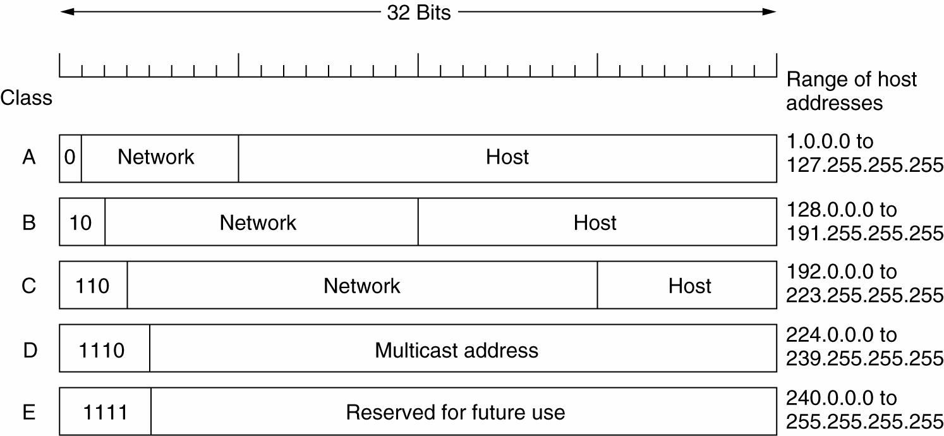
Class-full IPV4 Address

Slide 8
IPV4 Address Class
Class A
• Range : 0 – 127
So total of 126 (2⁷) Networks are possible and total host = 2²⁴ in each Network.
Default subnet mask is 255.0.0.0
Class B
• Range : 128 – 191
So total of 2¹⁴ Networks are possible and total host = 2¹⁶ in each
Network.
Default subnet mask is 255.255.0.0

Slide 9
IPV4 Address Class
Class C
• Range : 192 – 223
So total of 2²¹ Networks are possible and total host = 2⁸ in each Network.
Default subnet mask is 255.255.255.0
Class D
• Range : 224 – 239
Used for Multicasting
• E.g. 224.0.0.1 (group)
Class E
• Range 240-255
Not used ( for future use)

Slide 10
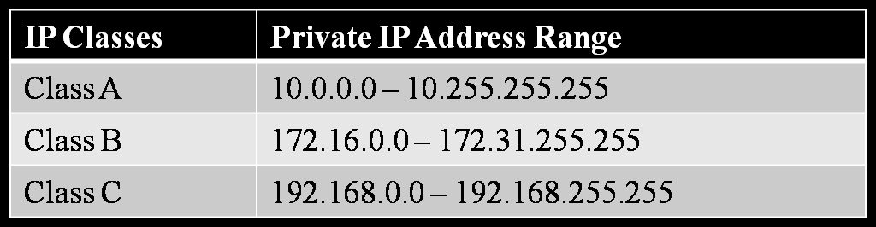
Public and Private IP Address
Public IP globally Unique
e.g. 202.70.91.7
•
Visible to public, people can access your device.
Private IP significant in Local Sites only.
Private IP are commonly used when the public IP couldn’t be
obtained for all devices.
Private IP address Range

Slide 11
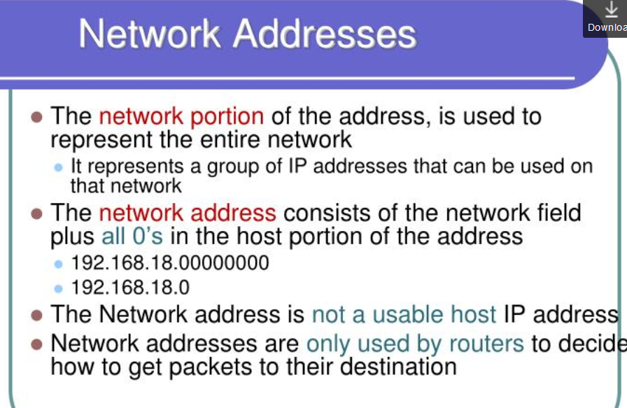

Slide 12
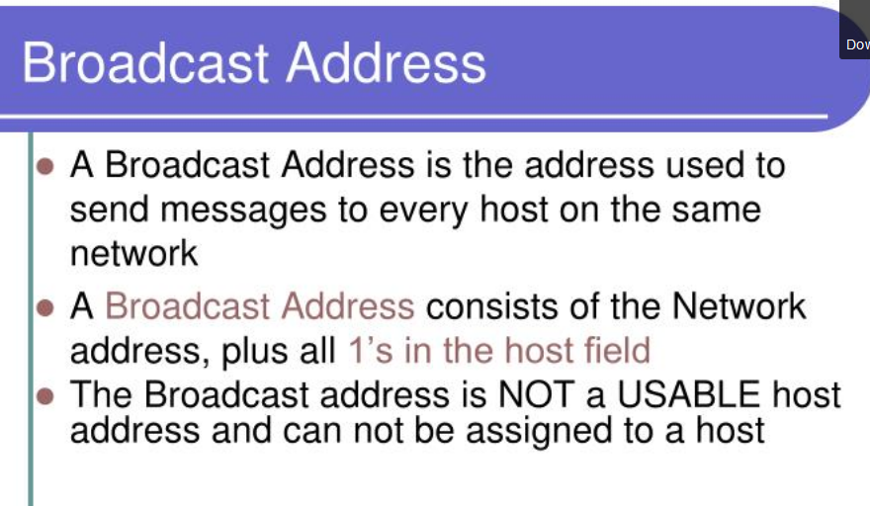

Slide 13


Slide 14
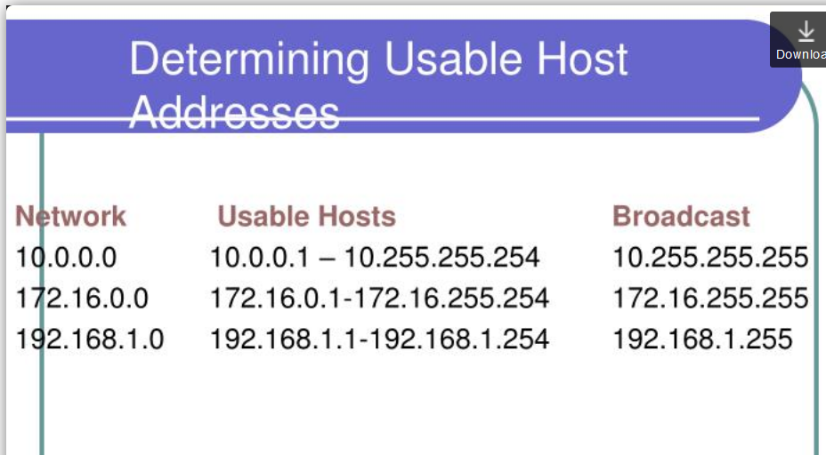

Slide 15
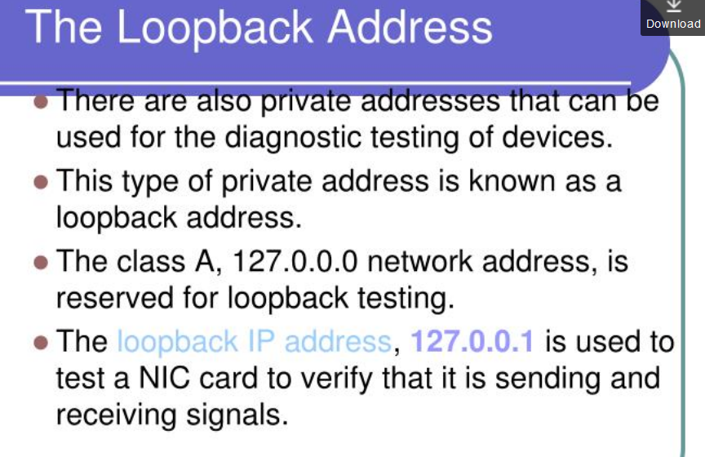

Slide 16
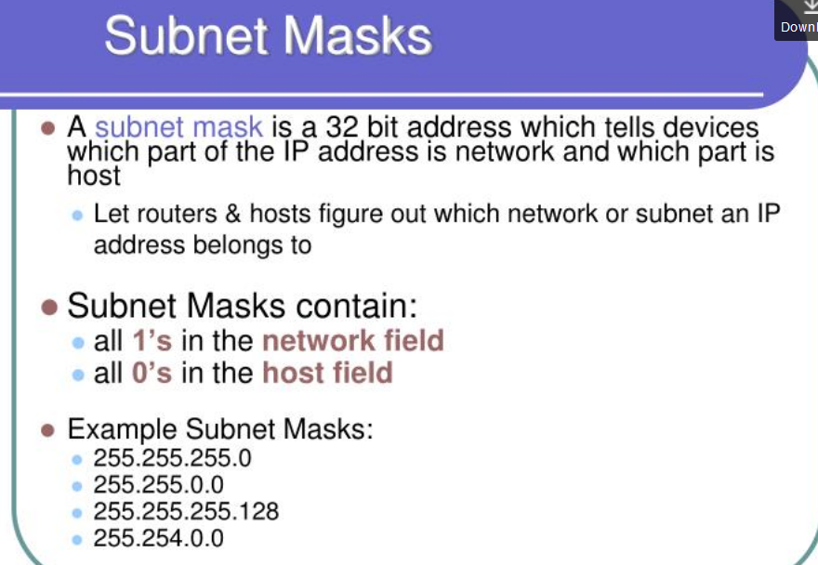

Slide 17
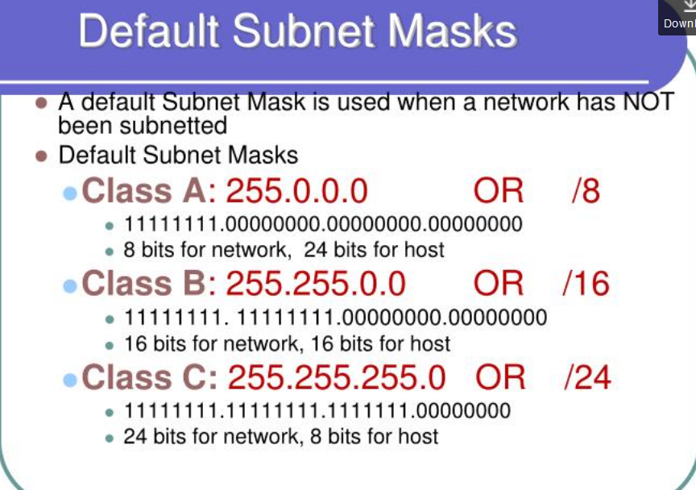

Slide 18
Subnetting
Subnetting is the process of dividing a large network into smaller, manageable sub-networks (subnets).
It allow you to divide a class A,B,C network address into smaller subnetworks, with their own network addresses.
Each subnet acts like its own LAN and it is connected to its own router interface.
Purpose:
- Efficient IP address utilization
- Improved security and performance
- Reducing broadcast traffic

Slide 19
Subnetting
IP Address: A 32-bit number (IPv4) uniquely identifying a host.
Subnet Mask: Separates the network portion from the host portion.
Network Address: The first address in a subnet; identifies the subnet.
Broadcast Address: The last address in a subnet; used to reach all hosts.

Slide 20
Fixed Length Subnet Masking (FLSM)
All subnets have the same number of hosts.
Example:
- IP: 192.168.1.0/24
- Divide into 4 subnets → 192.168.1.0/26
Subnets:
- 192.168.1.0 – 192.168.1.63
- 192.168.1.64 – 192.168.1.127
- 192.168.1.128 – 192.168.1.191
- 192.168.1.192 – 192.168.1.255

Slide 21
Variable Length Subnet Masking (VLSM)
Subnets have different sizes based on need.
Allows efficient IP usage.
Example:
- One department needs 60 hosts → /26
- Another needs 30 → /27
- Another needs 14 → /28

Slide 22
Subnetting Formulae
Number of Subnets: 2^n (where n is number of borrowed bits)
Number of Hosts per Subnet: 2^h - 2 (where h is number of host bits)
Valid Host Range: Between Network and Broadcast addresses

Slide 23
Subnetting Step-by-Step
1. Identify Class (A, B, C)
2. Convert subnet mask to binary
3. Calculate total subnets and hosts
4. List subnets (Network, Broadcast, Range)

Slide 24
Subnetting
Example:
Given: 192.168.10.0/24 - Required: 4 Subnets
-Borrow 2 bits → New mask: /26
Subnet 1:
- Network: 192.168.10.0
- Broadcast: 192.168.10.63
- Hosts: 192.168.10.1 – 192.168.10.62
Repeat for others.

Slide 25
Calculating Network & Broadcast Address
Use subnet block size: Block Size = 2^h
Next network address = Current network + block size
Broadcast = Next Network – 1
Network Address

Slide 26
Calculating Network & Broadcast Address
Calculating Network Address from given IP.
Convert IP Address to Binary
Convert Subnet Mask to Binary
Perform Bitwise AND Operation
Convert Result Back to Decimal

Slide 27
Calculating Network & Broadcast Address
Calculating Broadcast address from given IP.
Get the Network Address
Invert Subnet Mask to Binary (Change all 1s in the subnet mask to 0s, and all 0s to 1s.)
Perform Bitwise OR Operation
Convert Result Back to Decimal

Slide 28
Calculating Network & Broadcast Address
Given: 192.168.1.10/24
Find
Subnet Mask ?
Network Address ?
Broadcast Address ?
1st Usable Host ?
4th Usable Host ?
Last Usable Host ?

Slide 29
Calculating Network & Broadcast Address
Given: 192.168.1.10/24
Solution:
Subnet Mask: 255.255.255.0 → Block size = 256
Network Address: 192.168.1.0
Broadcast Address: 192.168.1.255
1st Usable Host: 192.168.1.1
4th Usable Host: 192.168.1.4
Last Usable Host :192.168.1.254

Slide 30
Calculating Network & Broadcast Address
Question 2
Given: 10.0.0.50/26
Find
Subnet Mask ?
Network Address ?
Broadcast Address ?
1st Usable Host ?
4th Usable Host ?

Slide 31
Calculating Network & Broadcast Address
Question 2
Given: 10.0.0.50/26
Solution:
Subnet Mask: 255.255.255.192 → Block size = 64
Network Address: 10.0.0.0
Broadcast Address: 10.0.0.63
1st Usable Host: 10.0.0.1
4th Usable Host: 10.0.0.4

Slide 32
Calculating Network & Broadcast Address
Question 3
Given: 10.10.10.33/30
Solution:
Subnet Mask ?
Network Address ?
Broadcast Address ?
1st Usable Host ?
4th Usable Host ?

Slide 33
Calculating Network & Broadcast Address
Question 3
Given: 10.10.10.33/30
Solution:
Subnet Mask: 255.255.255.252 → Block size = 4
Network Address: 10.10.10.32
Broadcast Address: 10.10.10.35
1st Usable Host: 10.10.10.33
4th Usable Host: ❌ Only 2 hosts in /30 → Not available

Slide 34
Number of Hosts & Networks
For Class C (example):
- Default: /24 → 256 addresses
- Submitted: /26 → 4 subnets (64 addresses each)
- Hosts/Subnet = 64 - 2 = 62
Why subtract 2?
- 1 for Network Address
- 1 for Broadcast Address

Slide 35
Summary Table
CIDR | Subnet Mask | Subnets | Hosts/Subnet
/24 | 255.255.255.0 | 1 | 254
/25 | 255.255.255.128 | 2 | 126
/26 | 255.255.255.192 | 4 | 62
/27 | 255.255.255.224 | 8 | 30
/28 | 255.255.255.240 | 16 | 14
/29 | 255.255.255.248 | 32 | 6
CIDR (/n): Short for Classless Inter-Domain Routing, this tells how many bits are used for the network portion of the IP address.
Subnet Mask: Shows the same thing as CIDR but in dotted decimal format (e.g., /25 = 255.255.255.128).
Subnets: Number of subnets created if you're subnetting a /24 network.
Hosts/Subnet: Number of usable host IP addresses in each subnet (excluding network and broadcast addresses).

Slide 36
Conclusion
Subnetting is essential for organizing and managing IP networks.
FLSM: Equal-size subnets
VLSM: Custom-size subnets for better efficiency
Use formulas and binary calculations for precise planning

Slide 37
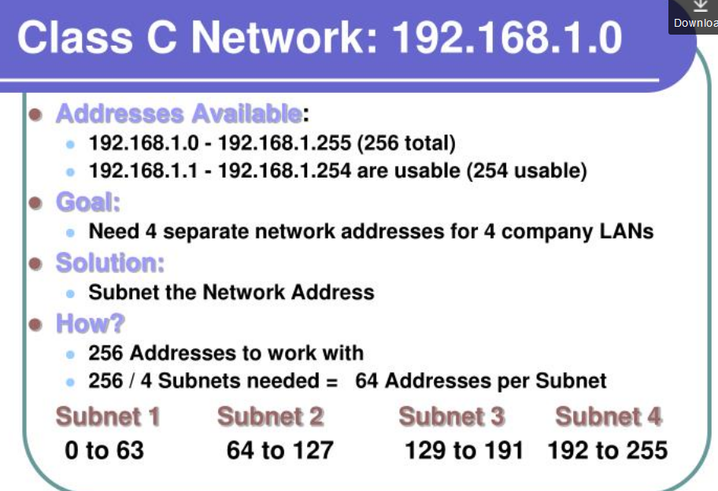

Slide 38
IP Sub-netting
Suppose there are 4 Departments A(23 Hosts), B(16), C(28), D(13). Given a network 202.70.64.0/24, perform sub-netting in such way that IP wastage in each sub-network is minimum. Find Subnet mask, N/W ID, Broadcast ID and usable host range for each network.
Available Network is 202.70.64.0/24
i.e. Total range of available IP addresses :
• 202.70.64.0 – 202.70.64.255
We proceed sub-netting with the department with highest no. of
host i.e. C and then A, B and D respectively.

Slide 39
IP Sub-netting
For Dept. C (Start with network with maxm hosts)
No. of hosts = 28
For No. of bits required for host(Suffix) part (H),
2^{H} -2 ≥ 28 => H = 5 (Select minimum value of H)
ie. Total no. of IP addresses this n/w can provide = 2⁵ = 32
No. of bits for Network(Prefix) part = 32 – 5 = 27
No. of Subnets that can be created = 2²⁷⁻²⁴ = 8, which are given below:
•
Available Subnets:
202.70.64.0/27 , 202.70.64.32/27, 202.70.64.64/27,
202.70.64.96/27 , 202.70.64.128/27, 202.70.64.160/27,
202.70.64.192/27 , 202.70.64.224/27
Let us Select Subnet for C as 202.70.64.0/27, then,
• Subnet Mask = 255.255.255.[11100000] = 255.255.255.224
Network ID = 202.70.64.0 (The first ip address of network)
Broadcast ID = 202.70.64.31 (The last ip address of network)
• Usable Host IP range = 202.70.64.1/27 – 202.70.64.30/27

Slide 40
IP Sub-netting
For Dept. A
No. of hosts = 23
For No. of bits required for host(Suffix) part (H),
2^{H} -2 ≥ 23 => H = 5 (Select minimum value of H)
ie. Total no. of IP addresses this n/w can provide = 2⁵ = 32
No. of bits for Network(Prefix) part = 32 – 5 = 27
No. of Subnets that can be created = 2²⁷⁻²⁴ = 8, which are given below: 202.70.64.0 / 27 is already used for Department C so cannot be used.
• Available Subnets: 202.70.64.32/27, 202.70.64.64/27, 202.70.64.96/27, 202.70.64.128/27, 202.70.64.160/27, 202.70.64.192/27,
202.70.64.224/27
Let us Select Subnet for A as 202.70.64.32/27, then,
• Subnet Mask = 255.255.255.[11100000] = 255.255.255.224
•
•
•
Usable Host IP range = 202.70.64.33/27 – 202.70.64.62/27
Network ID = 202.70.64.32
Broadcast ID = 202.70.64.63
(The first ip address of network)
(The last ip address of network)

Slide 41
IP Sub-netting
•For Dept. B
No. of hosts = 16
For No. of bits required for host(Suffix) part (H),
2^{H} -2 ≥ 16 => H = 5 (Select minimum value of H)
ie. Total no. of IP addresses this n/w can provide = 2⁵ = 32
No. of bits for Network(Prefix) part = 32 – 5 = 27
No. of Subnets that can be created = 2²⁷⁻²⁴ = 8, which are given below: 202.70.64.0 / 27 and 202.70.64.32/27 are already used for Departments C and A, so cannot be used.
• Available Subnets: 202.70.64.64 / 27, 202.70.64.96/27, 202.70.64.128/27,
202.70.64.160 / 27, 202.70.64.192/27 , 202.70.64.224/27
Let us Select Subnet for B as 202.70.64.64 / 27, then,
• Subnet Mask = 255.255.255.[11100000] = 255.255.255.224
•
•
•
Network ID = 202.70.64.64
Broadcast ID = 202.70.64.95
(The first ip address of network)
(The last ip address of network)
Usable Host IP range = 202.70.64.65/27 – 202.70.64.94/27

Slide 42
IP Sub-netting
•For Dept. D
No. of hosts = 13
For No. of bits required for host(Suffix) part (H),
2^{H} -2 ≥ 13 => H = 4 (Select minimum value of H)
ie. Total no. of IP addresses this n/w can provide = 2⁴ = 16
No. of bits for Network(Prefix) part = 32 – 4 = 28
No. of Subnets that can be created = 2²⁸⁻²⁴ = 16
(IP addresses upto 202.70.64.95 are already occupied)
Let us Select Subnet for D as 202.70.64.96 / 28, then,
• Subnet Mask = 255.255.255.[11110000] = 255.255.255.240
•
•
•
Network ID = 202.70.64.96
Broadcast ID = 202.70.64.111
(The first ip address of network) (The last ip address of network)
Usable Host IP range = 202.70.64.97/28 – 202.70.64.110/28

Slide 43
#Assignment
1) A large number of consecutive IP addresses are available at 202.70.64.0/19. Suppose that four organization A, B, C, D request 100, 500, 800 and 400 addresses respectively. How the subnetting can be performed so that address wastage will be minimum ?
2) Banijya Bank need to allocate 15 IPs in HR department, 30 in finance Department, 24 in customer care unit and 25 in ATM machines. If you have one network of class C range public IP address. Describe how you will manage it ?

Slide 44
Classful Addressing
Classful addressing divides the IP address space into fixed-size classes. Each class has a default subnet mask and range.
Class | Starting Bits | Range (Decimal) | Default Subnet Mask | Hosts per Network
A | 0xxxxxxx | 1.0.0.0 – 126.255.255.255 | 255.0.0.0 (/8) | ~16 million
B | 10xxxxxx | 128.0.0.0 – 191.255.255.255 | 255.255.0.0 (/16) | ~65,000
C | 110xxxxx | 192.0.0.0 – 223.255.255.255 | 255.255.255.0 (/24) | 254
D | 1110xxxx | 224.0.0.0 – 239.255.255.255 | (Multicast) | -
E | 1111xxxx | 240.0.0.0 – 255.255.255.255 | (Experimental) | -

Slide 45
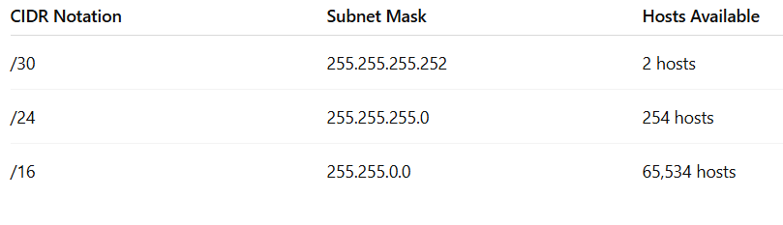
Classless Addressing (CIDR – Classless Inter-Domain Routing)
Classless addressing does not use fixed classes. Instead, it uses a prefix length (e.g., /24, /16) to define the network and host portions.
CIDR Notation:
Written as: IP address/prefix
Example: 192.168.1.0/24 → 24 bits for network, 8 bits for host.
Features:
Efficient IP usage (no wastage).
Flexible: You can divide and assign blocks as per need.
Used for subnetting and supernetting.
Example:

Slide 46
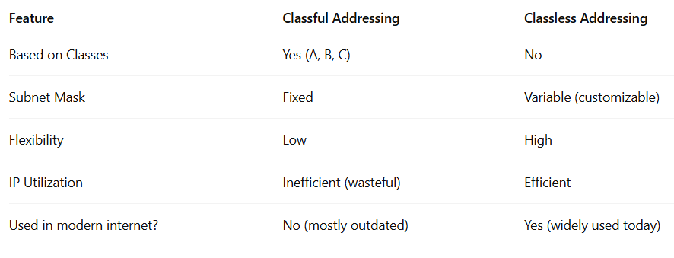
Classful Addressing Vs Classless Addressing

Slide 47
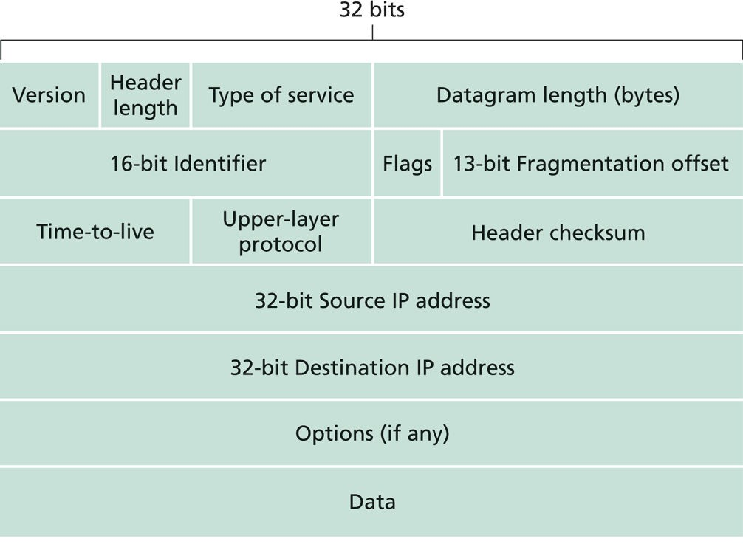
IPV4 Datagram Format
An IPv4 datagram is a packet of data that is transmitted over an IPv4 (Internet Protocol version 4) network.

Slide 48
IPV4 Datagram Format
Version (4 bits): IP version (always 4 for IPv4)
Header Length (4 bits): Because an IPV4 datagram can contain a variable number of options these four bits are needed to determine where in the IP datagram the data actually begins(minimum HLEN
= 20 bytes).
Type of Service (8 bits): TOS is included in the IPV4 header to allow different types of IP datagram(e.g. datagram particularly requiring low delay, high throughput, or reliability ) to be distinguished from other. Eg. Realtime data requires fast delivery, file transfer requires reliability.
Datagram Length(16 bits): contains the total length of datagram (Header+ Datagram)

Slide 49
IPv4 Datagram Format
Identifier, flag and Fragmentation offset : Used for identifying fragments of the same datagram.
Time to Live (8 bits) : to ensure that the datagram don't circulate forever in the network. Limits Packet Life. In practice, just counts hops. Each router decrements the TTL and upon hitting 0, packet is discarded.
Upper layer Protocol(8bits): The Protocol field in the IPv4 header is an 8-bit field that tells what kind of data (which protocol) is inside the datagram. In other words. It tells the IP layer which upper-layer protocol (like TCP, UDP, ICMP, etc.) should handle the payload.
•
•
•

Slide 50
IPV4 Datagram Format
Header Check sum (16 bits): used to detect an error that may occur in the header.
Source and Destination address: Carries 32-bits source and destination address.
Options: used to identify several additional services, not used in
every datagram.
Data: contains the user data.

Slide 51
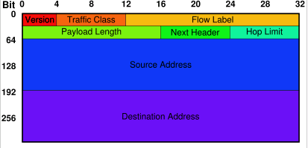
IPv6 Packet Format

Slide 52
IPv6 Packet Format
Version – Always 6 for IPV6.
Traffic Class - Similar to IPv4’s Type of Service (used for priority and QoS)
Flow label - Used to label packets in the same "flow" (for QoS)
Payload Length - Length of the payload (excluding header)
Next Header - Identifies the next header .
Hop Limit - Same as TTL in IPv4; decrements at each router
Source Address - IPv6 address of the sender.
Destination Address - IPv6 address of the receiver.

Slide 53
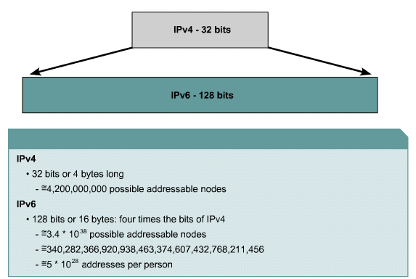
IPv6: Large Address Space

Slide 54
IP Packet
An IP packet has two fundamental components:
IP header
contains many fields that are used by routers to forward the packet from network to network to a final destination.
identify the sender, receiver, and transport protocol and define many other Parameters.
Payload
Represents the information (data) to be delivered to the receiver by the sender.
Contains data & upper-layer information.

Slide 55
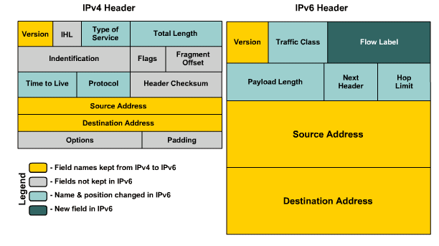
IPv4 vs IPv6 Header

Slide 56
Limitations of IPv4
→ Address Space
→ Various unnecessary and Variable header fields
→ Fragmentation in Router
→ Addressing Model
→ NAT
→ Broadcast Versus Multicast
→ Quality of Service
Most important changes introduced in IPv6
→ Expanded addressing capabilities
 Size increases from 32 bits to 128 bits. This ensures that the IP address wouldn’t run
out of IP addresses.
 In addition to unicast and multicast addresses, it introduced anycast address, which
allows a datagram to be delivered to any one of a group of hosts.
→ A streamlined 40 bytes header
 Allows for faster processing of the IP datagram
→ Flow labelling and priority
 Has an elusive definition of flow.(according to quality of service or real time service
e.g. audio and video transfer).

Slide 57
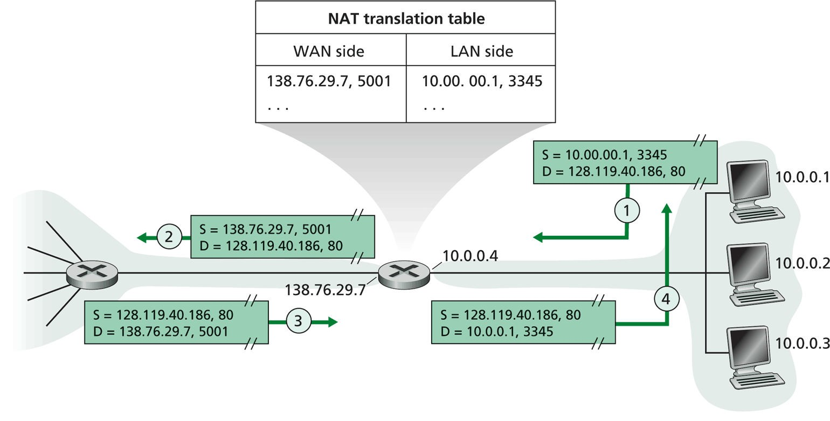
Network Address Translation (NAT)
Compiled By: MRU

Slide 58
Network Address Translation (NAT)
Network Address Translation (NAT) is a process used in computer networks to modify the IP address information in IP packet headers while they are in transit across a router or firewall. NAT allows multiple devices on a private network to share a single public IP address when accessing the internet.
Why is NAT needed?
IPv4 address shortage: There are limited IPv4 addresses, and NAT helps conserve them by allowing many devices to share one public IP.
Security: NAT hides internal private IP addresses from the external network, providing a layer of security.
Simplifies IP management: Private IPs can be reused inside different networks without conflict.

Slide 59
Network Address Translation (NAT)
How NAT works:
Devices inside a private network have private IP addresses (e.g., 192.168.x.x, 10.x.x.x).
When a device wants to communicate with the internet, the NAT-enabled router translates the private IP to the router’s public IP.
The router keeps track of outgoing connections using port numbers so that responses can be routed back to the correct internal device.
When the response arrives, the NAT device translates the public IP back to the private IP and forwards the packet inside.

Slide 60
Transition scenarios from IPv4 to IPv6
All IPv4
Mixed IPv4/IPv6
IPv4
IPv4
IPv4
IPv4
IPv6
IPv6
IPv4
IPv4
IPv4
IPv4
IPv4
IPv4
IPv4
IPv6
IPv6
IPv4
IPv4
IPv6
IPv6
IPv4
IPv6
IPv6
IPv6
IPv6
IPv6
IPv4
IPv6
IPv6
IPv6
IPv6
All IPv6
Compiled By: MRU

Slide 61
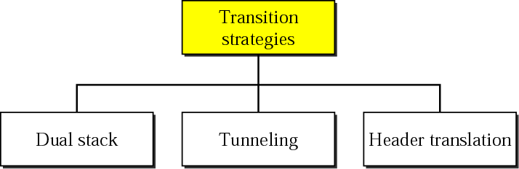

Slide 62
How Transition Happens From IPv4 to IPv6?
Various organizations are currently working with IPv4 technology and in a very short time, we can not switch directly from IPv4 to IPv6. Instead of only using IPv6, we use a combination of both and transition means not replacing IPv4 but co-existing of both.
When we want to send a request from an IPv4 address to an IPv6 address, it is not possible because IPv4 and IPv6 transition is not compatible. For a solution to this problem, we use some technologies that help in an easy transition from IPv4 to IPv6. These technologies are mentioned below:
Dual Stack Routers
Tunneling
Header Translation

Slide 63
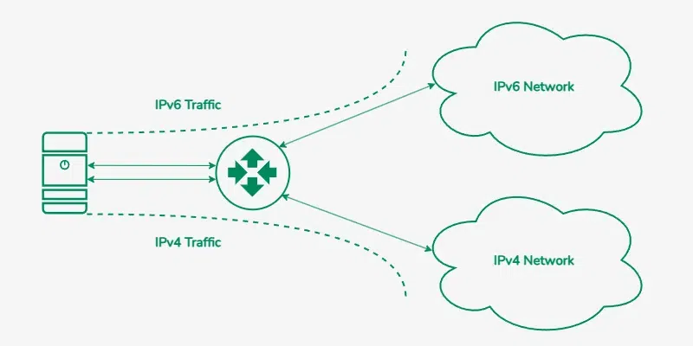
Dual stack
Dual-Stack Routers
A dual-stack router is a network device that can support both IPv4 and IPv6 protocols simultaneously. It allows communication between devices using any of the protocol, making it a key component during the transition from IPv4 to IPv6. In dual-stack router, A router's interface is attached with IPv4 and IPv6 addresses configured are used in order to transition from IPv4 to IPv6.

Slide 64
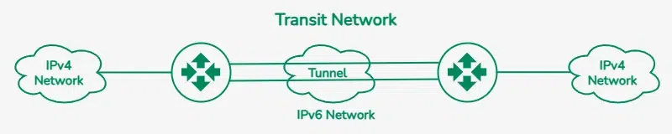
Tunneling
Tunneling is a technique used to enable communication between IPv4 and IPv6 networks during the transition from IPv4 to IPv6. Tunneling encapsulates IPv6 packets within IPv4 packets (or vice versa). Tunneling is used as a medium to communicate the transit network with the different IP versions.

Slide 65
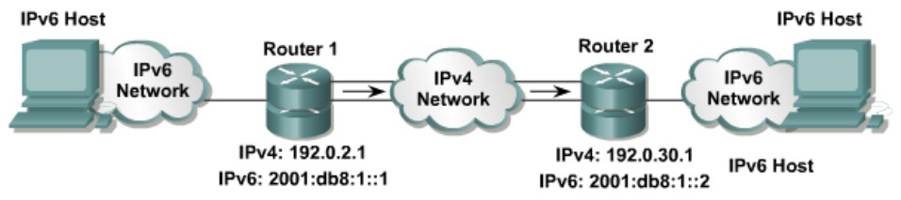
Tunneling technique
With manually configured IPv6 tunnels, an IPv6 address is configured on a tunnel interface, and manually configured IPv4 addresses are assigned to the tunnel source and the tunnel destination. The host or router at each end of a configured tunnel must support both the IPv4 and IPv6 protocol stacks.

Slide 66
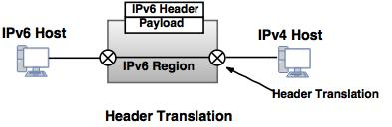
Header translation
Header translation is necessary when the majority of the Internet has moved to IPv6 but some systems still use IPv4. The sender wants to use IPv6, but the receiver does not understand IPv6. In this case, the header format must be totally changed through header translation. The header of the IPv6 packet is converted to an IPv4 header.
Header Translation changes the packet header from IPv6 to IPv4 or vice versa, allowing direct communication between IPv4 and IPv6 devices. This is done using protocol translation techniques like NAT64 and DNS64.

Slide 67
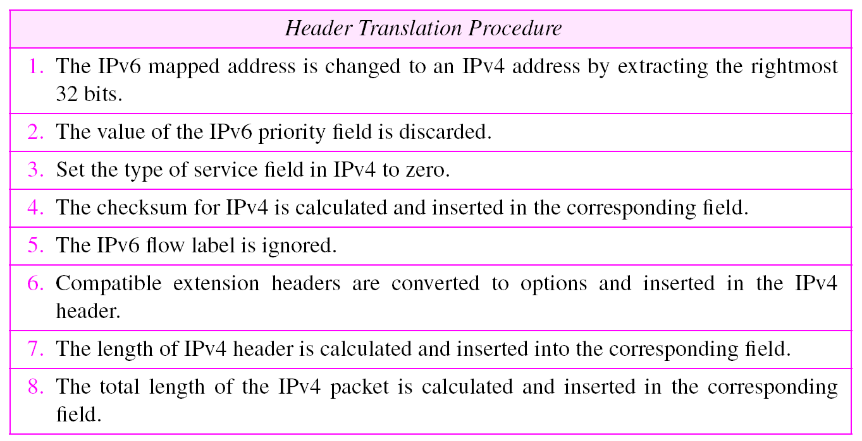
Header translation protocol
Compiled By: MRU

Slide 68
Datagram Fragmentation and Re-assembly
MTU(Maximum Transfer Unit) is defined for a network link. Eg. MTU for Ethernet packet is usually 1500 bytes
So, if data size is greater than MTU, it must be fragmented into
smaller packet before transmitting to the link and
re-assembled at receiver side to get original packet.
In case of IPv4, Fragmentation is done at router just before the link with smaller MTU (where as, in case of IPv6, it must be done by the sender)
For each Fragment, Header must be attached with Datagram ID,
offset and Flag.

Slide 69
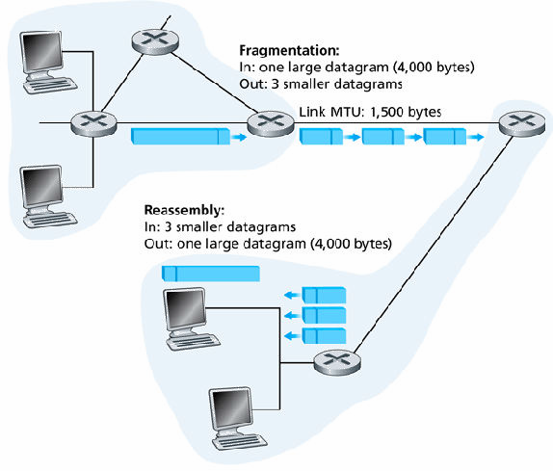
Datagram Fragmentation and Re-assembly
Datagram Size = 4000 Actual data size = 4000-20
= 3980 bytes
MTU = 1500 including 20
byte header
So fragmented packet size:
1st frag. : 1480 + 20 (Header) 2nd frag. : 1480 + 20 (Header) 3rd frag. : 1020 + 20 (Header)
Fragment | Bytes | ID | Offset | Flag (MF)
1st Fragment | 1480 bytes in data field of IP Datagram | 777 (eg.) | Offset = 0 (Beginning part) | MF = 1 (more fragments)
2st Fragment | 1480 bytes in data field of IP Datagram | 777 | Offset = 1480 (beginning at byte 1480) | MF = 1 (more fragments)
3st Fragment | 1020 bytes in data field of IP Datagram | 777 | Offset = 2960 (beginning at byte 2960) | MF = 0 (no more fragments)

Slide 70
ICMP (Internet Control Message Protocol)
ICMP stands for Internet Control Message Protocol.
It is an integral part of the IP protocol suite (used with IPv4 and IPv6).
ICMP is primarily used for error reporting and diagnostic functions in an IP network.
It is not used for sending data between systems, but for sending control messages related to network operations

Slide 71
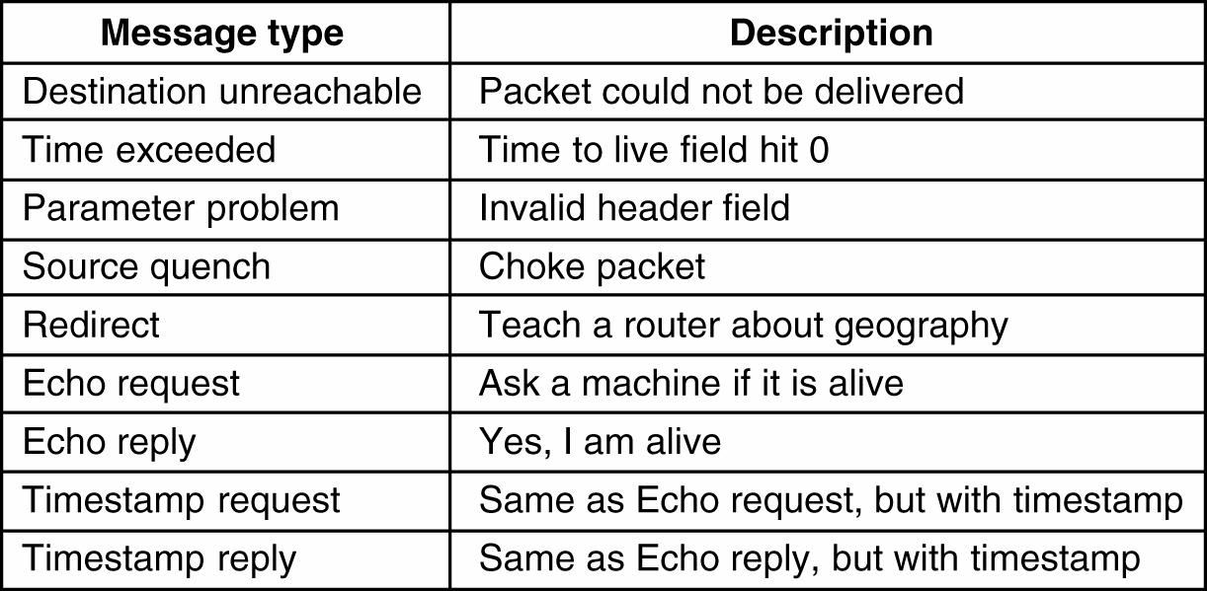
ICMP (Internet Control Message Protocol)
Note: Source Quench- It is used to tell a sender to slow down the rate of packet transmission.

Slide 72
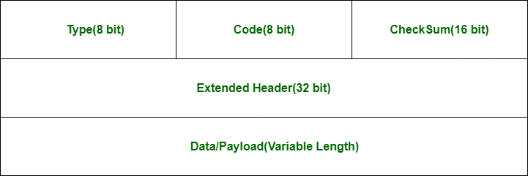
ICMP Packet Format

Slide 73
ICMP Packet Format
Field Name | Size (bits) | Description
Type | 8 bits | Specifies the type of ICMP message (e.g., Echo Request = 8, Echo Reply = 0)
Code | 8 bits | Provides further information about the Type (e.g., 0 = network unreachable, 1 = host unreachable)
Checksum | 16 bits | Used for error-checking the ICMP message (like parity for errors)
Extended Header | 32 bits | Varies depending on the Type and Code. For example: • Echo messages include an Identifier and Sequence Number • Error messages contain the IP header and first 8 bytes of the original packet

Slide 74
ARP (Address Resolution Protocol)
In a local LAN, Computers communicates using MAC address.
Sometimes it may so happen that Source knows IP address of destination, but not Physical address.
In such Case, the source broadcasts an ARP packet asking for MAC
address of computer with given IP.
Obviously, IP will match with at most one host in network that will reply back with it’s MAC address.
ARP associates an IP address with its physical address. On a typical physical network, such as a LAN, each device on a link is identified by a physical or station address that is usually imprinted on the NIC.

Slide 75
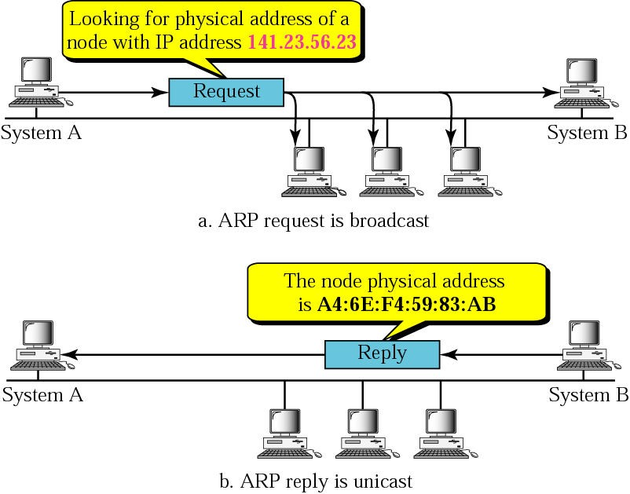
ARP (Address Resolution Protocol)
Compiled By: MRU

Slide 76
RARP (Reverse Address Resolution Protocol)
Just a reverse of ARP
RARP (Reverse Address Resolution Protocol) is a protocol by which a physical machine in a local area network can request to learn its IP address from a gateway server's Address Resolution Protocol (ARP) table or cache.
A network administrator creates a table in a local area network's gateway router that maps the physical machine (or Media Access Control - MAC address) addresses to corresponding Internet Protocol addresses.
When a new machine is set up, its RARP client program requests from the RARP server on the router to be sent its IP address. Assuming that an entry has been set up in the router table, the RARP server will return the IP address to the machine which can store it for future use.
RARP requests are broadcast, RARP replies are unicast.
DHCP have replaced RARP. RARP is now obsolete.
Compiled By: MRU

Slide 77
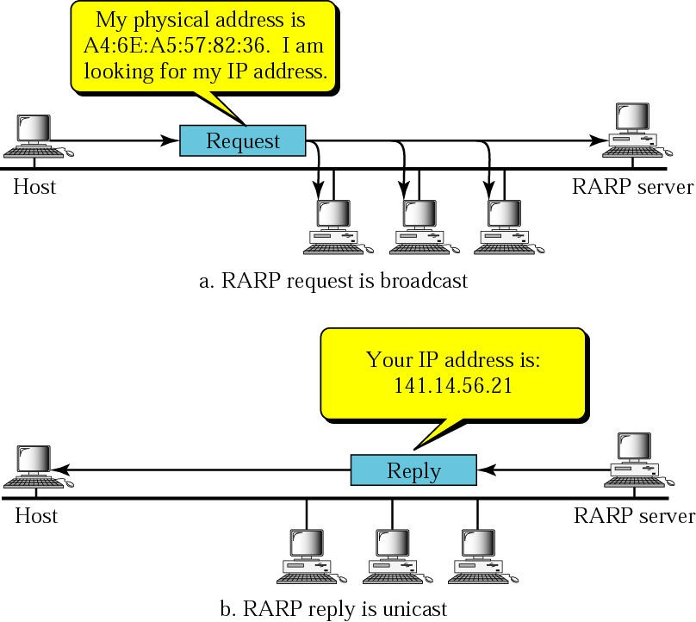
RARP (Reverse Address Resolution Protocol)
Compiled By: MRU

Slide 78
Routing
Routing is the process of selecting paths in a network along which to send network traffic. It occurs at the Network Layer (Layer 3) of the OSI model and involves moving packets from source to destination across multiple networks.
Key Terms:
Router: A device that forwards packets between networks.
Routing Table: A data table stored in a router that lists the routes to particular network destinations.
Hop: A step from one router to the next in a path.

Slide 79
Routing Techniques
Routing Types
Static Routing (Non-adaptive) Algorithm
Dynamic Routing (Adaptive) Algorithm
Routing Algorithms
Shortest Path Algorithm
Flooding
Optimality Principle (Bellman’s Principle)
Distance Vector Routing Algorithm
Link State Routing Algorithm
Routing Protocols
RIP(Routing Information Protocol)
OSPF(Open Shortest Path First)
BGP(Border Gateway Protocol)

Slide 80
Autonomous System
An Autonomous System (AS) is a group of network devices, such as routers, that are under a single administrative control and have a common routing policy.
An Autonomous System (AS) is a collection of IP networks and routers under the control of a single organization, which follows a single, consistent routing policy.
Each AS is assigned a unique Autonomous System Number (ASN) by a central authority (e.g., IANA or regional Internet registries like APNIC, ARIN, etc.).
ASes are a fundamental building block of the internet's routing infrastructure, and they play a critical role in determining the paths that data takes as it travels across the internet. Within an AS, routing decisions are made based on the policies of the network administrator.

Slide 81
Routing
Routing is the process of determining the best path for data to travel between two or more networked devices. When data is transmitted over a network, it is broken up into packets, each of which contains a destination address. The routing process determines the path that each packet should take to reach its destination.
Different algorithms and protocols can be used to figure out how to best route data packets, and which nodes should be used.
Key Terms:
Router: A device that forwards packets between networks.
Routing Table: A data table stored in a router that lists the routes to particular network destinations.
Hop: A step from one router to the next in a path.
The following are the different types of routing:
Static Vs Dynamic Routing
Unicast Vs Multicast Routing
Interior Vs Exterior Routing
Link State Vs Distance Vector Routing

Slide 82
Static Vs Dynamic Routing
Static routing is a method of configuring the network routing manually by the network administrator. In this method, the network administrator configures the routing table on each network device with static routes, which specify the next hop for data packets to travel to reach their destination.
Advantages –
simple and efficient for small networks with a fixed topology that do not change frequently.
No routing overhead for router CPU which means a cheaper router can be used to do routing.
It adds security because only administrator can allow routing to networks only.
Disadvantage –
For a large network, it is a hectic task for administrator to manually add each route for the network in the routing table on each router.
The administrator should have good knowledge of the topology. If a new administrator comes, then he must manually add each route so he should have very good knowledge of the routes of the topology.
Static routing does not adapt to changes in the network topology and requires manual intervention to update the routing table if changes occur, which can be time-consuming and error-prone.

Slide 83
Static Vs Dynamic Routing
Dynamic routing, on the other hand, is a method of exchanging routing information automatically between network devices using routing protocols.
In this method, the network devices exchange information about the network topology and use algorithms to calculate the best path for data packets to travel to their destination.
Dynamic routing is more flexible than static routing and can adapt to changes in the network topology, such as the addition or removal of network devices or links, without requiring manual intervention.
Examples of dynamic routing protocols include OSPF (Open Shortest Path First), BGP (Border Gateway Protocol), and RIP (Routing Information Protocol).

Slide 84
Static Vs Dynamic Routing
Feature | Static Routing | Dynamic Routing
Definition | Routes are manually configured by a network admin. | Routes are learned and updated automatically using routing protocols.
Configuration | Manual | Automatic via routing protocols (e.g., RIP, OSPF)
Routing Table Update | Only changes if the admin updates it | Updates dynamically based on network conditions
Protocols Used | No protocol needed | Uses RIP, OSPF, EIGRP, BGP, etc.
Scalability | Poor — hard to manage large networks | Good — suitable for large, complex networks
Security | More secure — no external updates | Less secure — vulnerable to route poisoning, spoofing
Maintenance | High — must update routes manually | Low — routes updated automatically

Slide 85
Unicast Vs Multicast Routing
Unicast routing is a method of transmitting data packets from a single sender to a single receiver. In this method, the data packet is sent to a specific IP address, and the network devices along the way use routing protocols to forward the packet to its destination. This method is commonly used for communication between two devices, such as a web browser requesting a web page from a server.
Multicast routing, on the other hand, is a method of transmitting data packets from a single sender to multiple receivers. In this method, the data packet is sent to a group of IP addresses, and the network devices along the way use multicast routing protocols to replicate and forward the packet to all the devices in the group. This method is commonly used for streaming media, such as video or audio, to multiple devices at the same time.

Slide 86
Unicast Vs Multicast Routing
Feature | Unicast Routing | Multicast Routing
Definition | Sends packets from one sender to one specific receiver (one-to-one). | Sends packets from one sender to multiple selected receivers (one-to-many).
Communication Type | One-to-one | One-to-many
Packet Delivery | One packet per destination | One packet sent once, duplicated by routers only when needed
Addressing | Uses unicast IP addresses (e.g., 192.168.1.1) | Uses multicast IP addresses (224.0.0.0 to 239.255.255.255)
Routing Table | Contains entries for each destination | Maintains multicast group membership info
Delivery Model | Direct packet delivery to a single IP | Packet replication happens at routers to reach group members

Slide 87
Interior Vs Exterior Routing
Interior routing is a Routing mechanism which is used to find network path information within an Autonomous System. Known Interior Routing Protocols are Routing Information Protocol (RIP), Interior Gateway Routing Protocol (IGRP), Open Shortest Path First (OSPF), etc.
Exterior routing is a Routing mechanism which is used to find network path information between different Autonomous Systems. Exterior Routing Protocols are commonly used on the Internet to exchange routing table information. There is only one Exterior routing protocol exists now and it is Border Gateway Protocol (BGP).

Slide 88
Interior Vs Exterior Routing
Feature | Interior Routing (IGP) | Exterior Routing (EGP)
Scope | Operates within a single Autonomous System (AS) | Operates between different Autonomous Systems (ASes)
Used By | Enterprises, ISPs (internally) | ISPs, large-scale Internet backbone providers
Routing Focus | Optimizes routing inside a network | Manages routing between networks on the Internet
Common Protocols | RIP, OSPF, EIGRP, IS-IS | BGP (Border Gateway Protocol)
Routing Control | Fully controlled by a single organization | Policy-based, partial control across different networks
Complexity | Simpler to manage | More complex, requires agreement between ASes

Slide 89
Popular Routing Algorithms
A routing algorithm is a set of step-by-step operations used to direct Internet traffic efficiently.
When a packet of data leaves its source, there are many different paths it can take to its destination.
The routing algorithm is used to determine mathematically the best path to take.
Dynamic routing algorithms are basically categorized as follows:
Shortest Path Algorithm: Bellman-Ford's algorithm and Dijkstra’s Algorithm
Distance Vector Algorithm: Routing Information Protocol (RIP)
Link State Algorithm: Open Shortest Path First (OSPF)
Path Vector Algorithm: Border Gateway Protocol (BGP).

Slide 90
Flooding
Flooding is a static routing algorithm, in which every incoming packet is sent out on every outgoing line except the one it arrived on.
Flooding obviously generates vast numbers of duplicate packets, in fact, an infinite number unless some measures are taken to damp the process.
Technique for damming the flood is to keep track of which packets have been flooded, to avoid sending them out a second time.
Achieve this goal is to have the source router put a sequence number
in each packet it receives from its hosts.
Compiled By: MRU

Slide 91
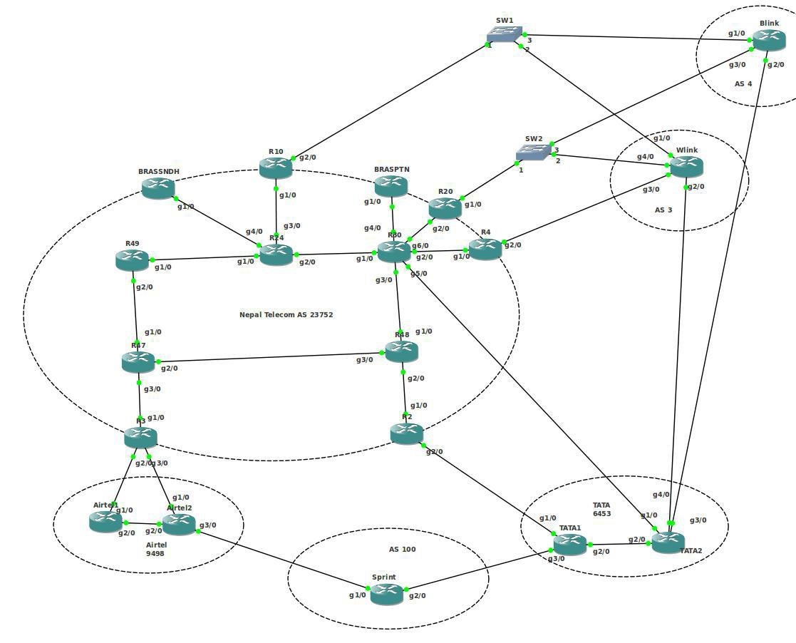
Flooding
Compiled By: MRU

Slide 92
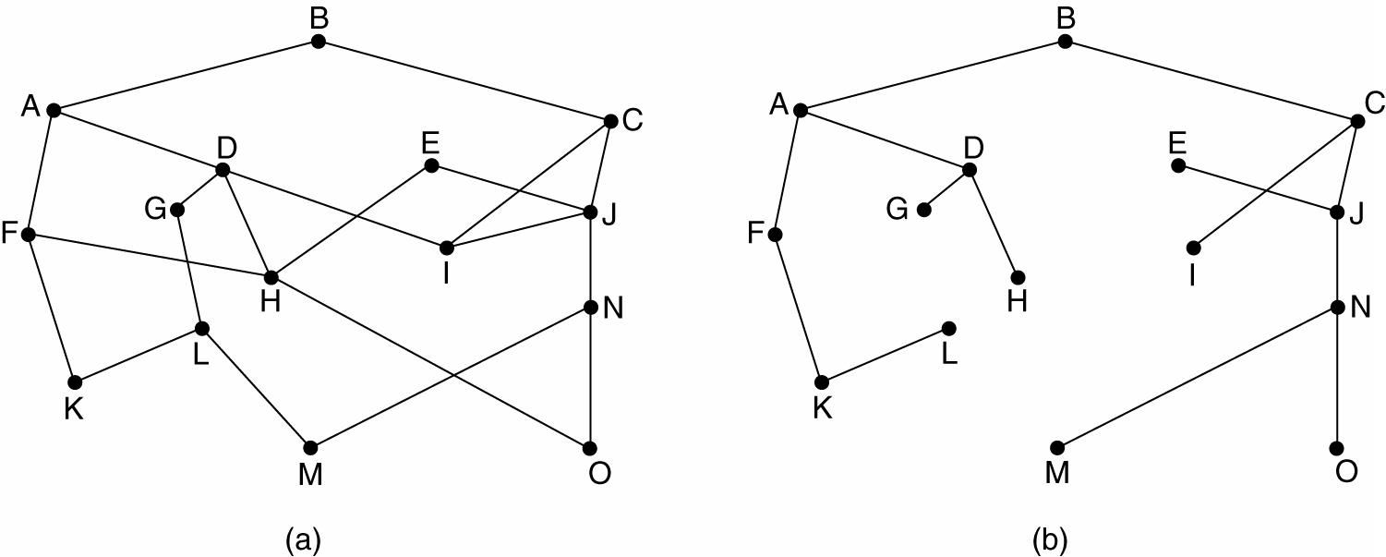
Optimality Principle
It states that if router J is on the optimal path from router I to router K,
then the optimal path from J to K also falls along the same route
(a) A subnet. (b) A sink tree for router B.
Compiled By: MRU

Slide 93
Dynamic Routing
Dynamic routing makes it possible to avoid the configuration of static routes.
Dynamic routing makes it possible to avoid the time-consuming and exacting process of configuring static routes.
Dynamic routing also makes it possible for routers to react to changes in the network and to adjust their routing tables accordingly, without the intervention of the network administrator.
Two types of Dynamic Routing Algorithm:
Distance Vector Routing
Link State Routing (Global Routing Algorithm)
Compiled By: MRU

Slide 94
Autonomous System
An Autonomous System is a collection of networks under a common administration that share a common routing strategy.
To the outside world, an AS is viewed as a single entity.
Regional Internet Registry distribute AS number.
Autonomous systems divide the global internetwork into smaller
and more manageable networks.
Each AS has its own set of rules and policies and an AS number that will distinguish it from all other autonomous systems
Compiled By: MRU

Slide 95
Routing Protocol According to AS
Interior Gateway Protocol (IGP)
Between same AS
Exterior Gateway Protocol (EGP)
Between different AS
Compiled By: MRU

Slide 96
Example of Routing Protocols
Routing Information Protocol (RIP)
Distance Vector interior routing Protocol and IGP
Interior Gateway Routing Protocol (IGRP) Distance Vector interior routing Protocol and IGP
Enhanced Interior Gateway Routing Protocol (EIGRP) Distance Vector interior routing Protocol and IGP
Open Shortest Path First (OSPF)
Link State interior routing Protocol and IGP
Border Gateway Routing Protocol (BGP)
Distance Vector exterior routing Protocol and EGP
NOTE:
Routing Between Same AS is called Interior Routing Protocol
Routing Between Different AS is called Exterior Routing Protocol
Compiled By: MRU

Slide 97
Distance Vector Algorithm (DV)
Operate by having each router maintain a table (i.e. a vector) giving the best known distance to each destination and which line to use to get there.
The distance vector routing algorithm passes periodic copies of a routing table from router to router. These regular updates between routers communicate topology changes.
These tables are updated by exchanging neighbors.
Also called Bellman-Ford routing algorithm.
•
information with the
The router is assumed to know the ''distance'' to each of its neighbors. If the metric is hops, the distance is just one hop. Metric may be delay time.
Compiled By: MRU

Slide 98
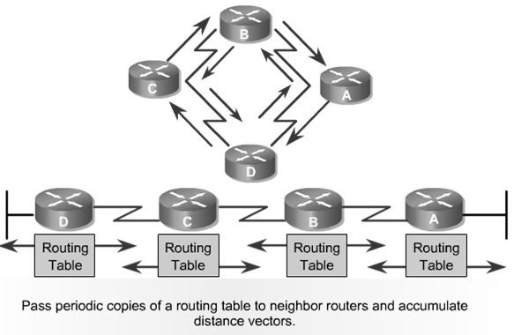
Distance Vector Algorithm
Each router receives a routing table from its directly connected neighbour routers.
Router B receives information from Router A. Router B adds a distance vector number, such as a number of hops.
This number increases the distance
vector. Then Router B passes this new routing table to its other neighbour, Router C.
This same step-by-step process occurs in all directions between neighbour routers.
Compiled By: MRU

Slide 99
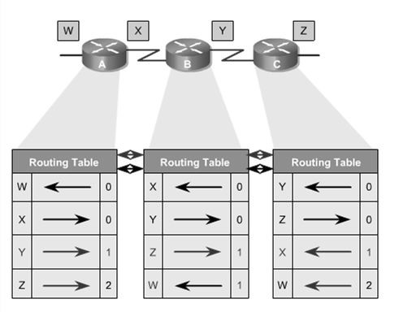
Distance Vector Algorithm
Compiled By: MRU

Slide 100
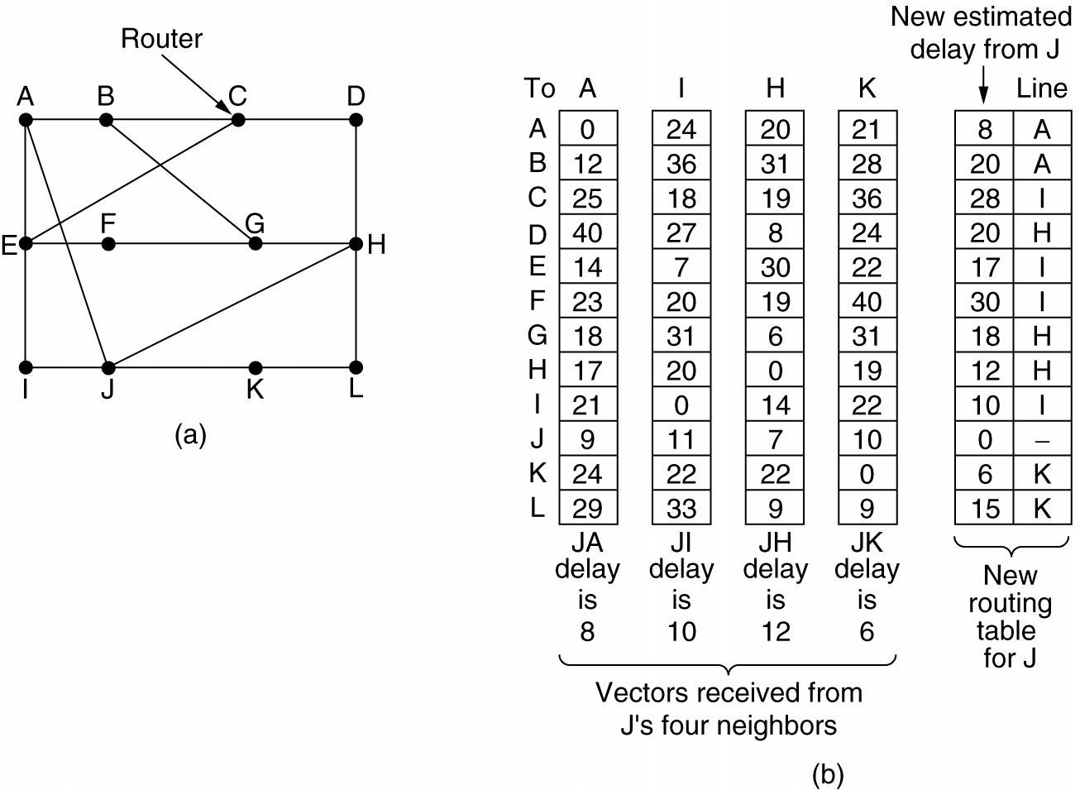
Distance Vector Algorithm
Compiled By: MRU

Slide 101
Distance Vector Algorithm
Path from J to B ( Multiple path)
▪ J → A → B = 8 + 12 = 20
▪ J → I → B = 10 + 36 = 46
▪ J → H → B = 12 + 31 = 43
Least cost Path = J → A → B so it is chosen.
Compiled By: MRU

Slide 102
Link-state Routing Algorithm(LS)
Distance Vector do not make good candidate for longer network and
Convergence and scalability problem for topology changes
The distance vector algorithm has nonspecific information about distant networks and no knowledge of distant routers.
Link state routing is used to overcome those limitations
The link-state routing algorithm maintains a complex database of topology information.
The link-state routing algorithm maintains full knowledge of distant
routers and how they interconnect.
Each node maintains the full graph by collecting the updates from all other nodes
Each node then independently calculates the next best logical path
from it to every possible destination in the network
Router's receive topology information from their neighbor router via link state advertisements(LSA)
Compiled By: MRU

Slide 103
Link-state Routing Algorithm(LS)
The link-state algorithm is also known as Dijkstra's algorithm or as the shortest path first (SPF) algorithm and uses Dijkstra's shortest path first algorithm to determine optimal paths
Link state protocols don't have to constantly resend their entire LSAs instead they can send small hello LSAs to let their neighbor routers know they are still alive
Link state routing uses following features:
Link-state advertisement (LSA) - a small packet of routing
information that is sent between routers
Topological database - a collection of information gathered from LSAs
SPF algorithm - a calculation performed on the database that results in the SPF tree
Routing table - a list of the known paths and interfaces
Compiled By: MRU

Slide 104
Concerns related to Link-state Routing
Processor Overhead
Memory Requirements
Compiled By: MRU

Slide 105
Dynamic Routing Protocol
Distance Vector | Link State
Entire routing table is sent as an update Distance vector protocol send periodic update at every 30 or 90 second Updates are sent to directly connected neighbor only Routers don't have end to end visibility of entire network. Suffer from count to infinity problem Examples: RIP | Updates are incremental & entire routing table is not sent as update. Updates are triggered not periodic. Update are sent to entire network & to just directly connected neighbor. Routers have visibility of entire network of that area only. No routing loops Convergence is fast because of triggered updates. Examples: OSPF, IS-IS
Compiled By: MRU

Slide 106
Hierarchical Routing
Problem with above Routing
Scale : As no. of routers become large, the overhead involved in computing, storing, and communicating routing information becomes prohibitive.
Administrative autonomy : An organization should be able to
run and administer its network as it wishes, while still being able to connect its network to other networks and hide network’s internal organization.
Both of these problems can be solved by organizing router into autonomous system(AS)
Compiled By: MRU

Slide 107
Routing in Internet
Routers within same AS run same routing algorithm called intra- autonomous system routing protocol or Interior Gateway Protocol – IGP (Intra-AS / Intra-Domain)
RIP(Routing Information Protocol),
OSPF(Open Shortest Path First)
IS-IS(Intermediate System-Intermediate System) ,
IGRP(Interior Gateway Routing Protocol),
EIGRP(Enhanced IGRP)
Routers responsible for routing packets to destination outside the AS
are called gateway router.
The routing algorithm that gateways use to route among the various AS is known as inter-autonomous system routing protocol or Exterior Gateway Protocol – EGP (Inter-AS / Inter-Domain)
Eg. BGP(Border Gateway Protocol)
Compiled By: MRU

Slide 108
Routing Information Protocol(RIP)
The Routing Information Protocol (RIP) is a distance-vector routing protocol.
One of earliest intra-AS internet routing protocol.
Employs the hop count as a routing metric.
RIP prevents routing loops by implementing a limit on the number of hops allowed in a path from the source to a destination.
The maximum number of hops allowed for RIP is 15.
This hop limit, however, also limits the size of networks that RIP can support.
A hop count of 16 is considered an infinite distance and used to deprecate inaccessible, inoperable, or otherwise undesirable routes in the selection process.
Compiled By: MRU

Slide 109
Routing Information Protocol(RIP)
Periodic updates every 30 seconds, even the topology not changed.
In the early deployments, routing tables were small enough that the traffic was not significant. As networks grew in size, however, it became evident there could be a massive traffic burst every 30 seconds, even if the routers had been initialized at random times.
RIP uses the User Datagram Protocol (UDP) as its transport protocol,
and is assigned the reserved port number 520.
RIP Types
RIP version 1
RIP version 2
RIPng (RIP next generation)
Compiled By: MRU

Slide 110
RIP Version 1
Uses classfull routing.
The periodic routing updates do not carry subnet information,
Lacking support for variable length subnet masks (VLSM).
There is also no support for router authentication, making RIP
vulnerable to various attacks.
Broadcast is used for database update
Compiled By: MRU

Slide 111
RIP Version 2
It included the ability to carry subnet information, thus supporting Classless Inter-Domain Routing (CIDR).
In an effort to avoid unnecessary load on hosts that do not
participate in routing,
RIPv2 multicasts the entire routing table to all adjacent routers at the address 224.0.0.9, as opposed to RIPv1 which uses broadcast.
Support Authentication.
Compiled By: MRU

Slide 112
RIPng (RIP Next Generation)
Support of IPv6 networking.
RIPng sends updates on UDP port 521 using the multicast group FF02::9.
Compiled By: MRU

Slide 113
Open Shortest Path First (OSPF)
Link State Routing Algorithm
Cost/Metric = Link Bandwidth
Shortest Path Algorithm to Calculate best path from source to destination.
Open Shortest Path First (OSPF) is an adaptive routing protocol for Internet Protocol (IP) networks.
It uses a link state routing algorithm and falls into the group of
interior routing protocols, operating within a system (AS). | single | autonomous
High convergence
Load balancing in multiple same-cost path
No hop limit
Event Triggered
Need High Memory and High Speed Processor
Admin distance = 110
Compiled By: MRU

Slide 114
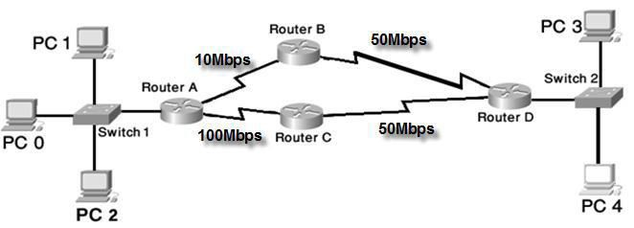
OSPF(Open Shortest Path First)
OSPF is perhaps the most widely-used interior gateway protocol
(IGP) in large enterprise networks
It included the ability to carry subnet information, thus supporting Classless Inter-Domain Routing (CIDR).
Supports Authentication
Compiled By: MRU

Slide 115
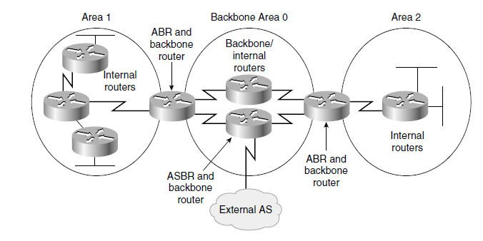
Routers in OSPF
Internal router
Backbone router
Area Border Router (ABR)
Autonomous System Boundary Router (ASBR)
Compiled By: MRU

Slide 116
Routers in OSPF
Internal Router
▫ Routers that have all interfaces in the same area are internal routers.
▫ Internal routers within the same area have identical link-state databases.
Backbone router
▫ Routers that sit in the backbone area.
▫ They have at least one interface connected to Area 0.
▫ These routers maintain OSPF routing information using the same procedures and algorithms as internal routers.
▫ Area 0 serves as the transit area between other OSPF areas.
Compiled By: MRU

Slide 117
Routers in OSPF
Area Border Router (ABR)
▫ Routers that have interfaces attached to multiple areas.
▫ These routers maintain separate link-state databases for each area to which they are connected, and route traffic destined for or arriving from other areas.
▫ ABRs
are exit points for the area, which means that routing
information destined for another area can get there only via the local
area’s ABR.
▫ ABRs may summarize information from their link-state databases of their attached areas and distribute the information into the backbone area.
▫ The backbone ABRs then forward the information to all other
connected areas. An area can have one or more ABRs.
Compiled By: MRU

Slide 118
Routers in OSPF
Autonomous System Boundary Router (ASBR)
▫ Routers that have at least one interface into an external internetwork (another autonomous system), such as a non- OSPF network and another interface within OSPF.
▫ These routers can import (referred to as redistribution) non-OSPF network information to the OSPF network, and vice versa.
Compiled By: MRU

Slide 119
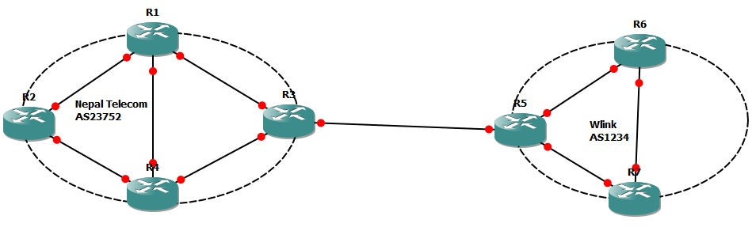
Border Gateway Protocol (BGP)
Exterior Gateway protocol
Called Path vector Routing Algorithm.
Neighbouring BGP routers i.e. BGP peers exchange detailed path information.
Used for communicating between two AS
Compiled By: MRU

Slide 120
Border Gateway Protocol (BGP)
The Routing Domain of BGP is the entire Internet.
The with reachability
protocols are more concerned than
optimality.
Revolves around three activities:
▫ Receiving and filtering route advertisement from directly attached
neighbours.
▫ Route Selection
▫ Sending route advertisements to neighbours.
Compiled By: MRU

Slide 121
Border Gateway Protocol (BGP)
The Routing Domain of BGP is the entire Internet.
The with reachability
protocols are more concerned than
optimality.
Revolves around three activities:
▫ Receiving and filtering route advertisement from directly attached
neighbours.
▫ Route Selection
▫ Sending route advertisements to neighbours.
Compiled By: MRU

Slide 122
Border Gateway Protocol (BGP)
The Routing Domain of BGP is the entire Internet.
The with reachability
protocols are more concerned than
optimality.
Revolves around three activities:
▫ Receiving and filtering route advertisement from directly attached
neighbours.
▫ Route Selection
▫ Sending route advertisements to neighbours.
Compiled By: MRU

Slide 123
Thank You !

